Slide 1

Final Group Project: Amazon Dataset
Brandon Mora, Michael Webb, Jonathan Diaz

Slide 2
Background
We found that the Amazon Dataset through Kaggle
This Dataset was a part of an Amazon India’s Business Research Analyst Assessment Challenge
The two collaborators that created the data set were Vikramjeet Singh and Gavesh Jain
The reason why the collaborators created the dataset was to attempt to land a position with Amazon as a Business Research Analyst
Since their dataset was on Kaggle this signifies that they did not win their challenge or else it could not be shared with the public.
The dataset had a total of 20 columns and 11,401 rows
Notes:
Brandon

Slide 3
Motivation for Using Dataset
The main motivation that we had for using the dataset was the different types of variables that were used within the dataset.
This dataset had categorical variables such as weather and road traffic conditions, date-time variables for dates the order was placed, a binary variable for multiple deliveries, numerical variables for longitude and latitude, and nvarchar variables that contained a string of numbers and characters for the order id and delivery person id.
Aside from this, the dataset had NaN values for data that was not able to be collected.
Notes:
Brandon

Slide 4
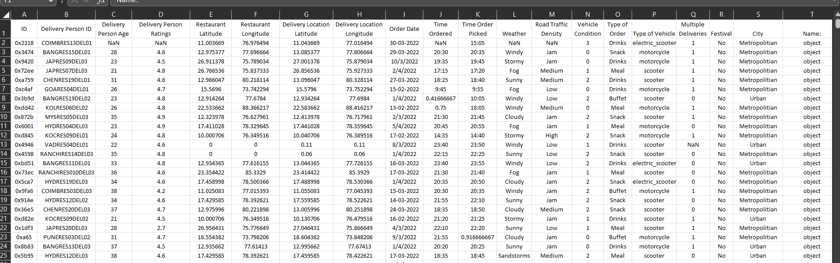
Original Dataset
Notes:
Michael Webb

Slide 5
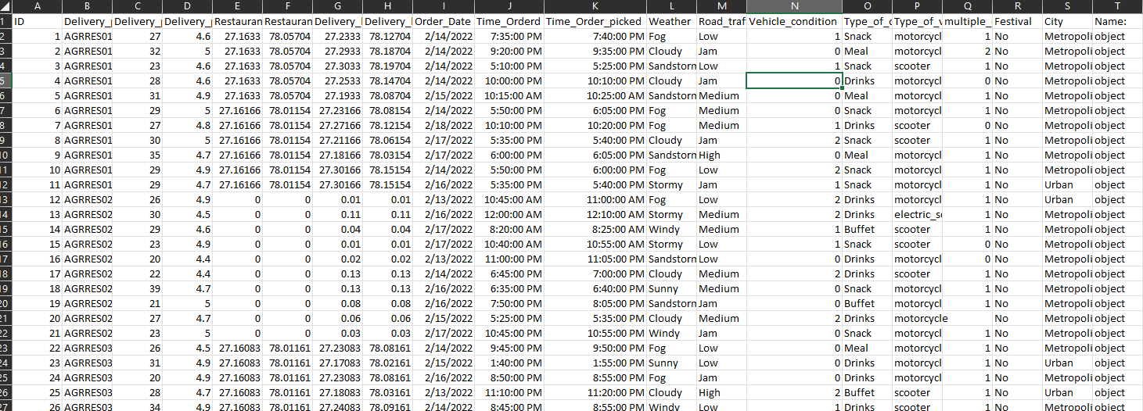
Updated Dataset
Notes:
Michael Webb

Slide 6
Motivation for Updating Dataset
Since there were NaN values in the original dataset we decided to convert them to null values.
Also, we created a few new sheets to include dummy information for some of the tables that we created in Erwin.
Creating dummy information helped with running different queries that we wanted to explore in SQL
The modifications to the old dataset did not make the new dataset perfect, but it helped in organizing the database system that we were trying to create.
Notes:
Michael Webb

Slide 7
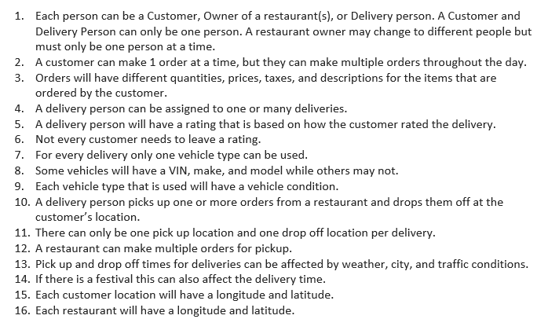
Business Rules
Notes:
Jonathan

Slide 8
Why we chose those Business Rules?
There was a lot of information in the dataset, so we wanted to try and make it clear on how the data should be split.
We wanted it to be simple to understand that there were three different types of people.
Also, we detailed what factors could affect the delivery, so that when the entities are made an individual would be able to see where the data begins to connect.
Along with that, we mentioned information that stated that there could be one option or multiple options.
Notes:
Jonathan

Slide 9
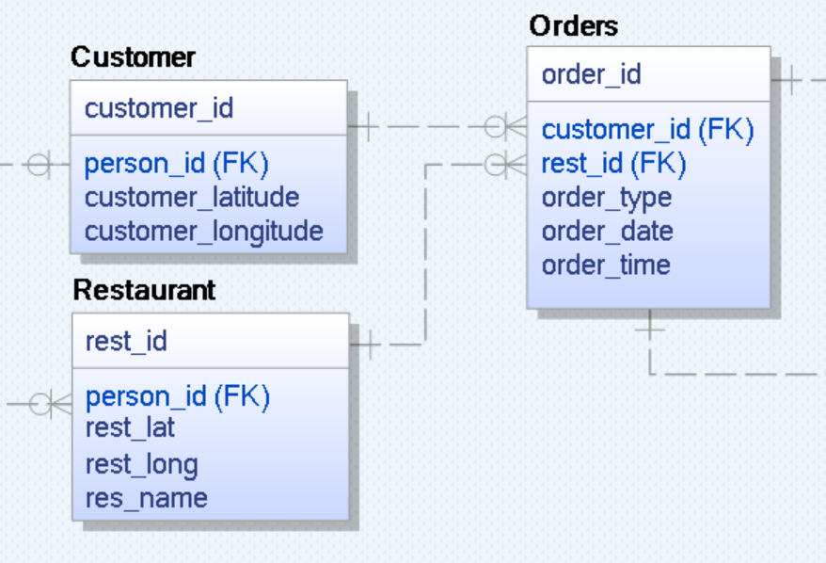
Erwin Data Model - Entities
Entities are defined as a objects of interest to the user.
Entities should not be confused with a row or entity instance rather the entity is a table that can have many entity instances.
The photo to the right shows three of the tables that we created for the dataset.
The entities have different relationships to one another, and they contain some similar information through foreign keys and some unique information that is not transferred from other entities.
Notes:
Brandon

Slide 10
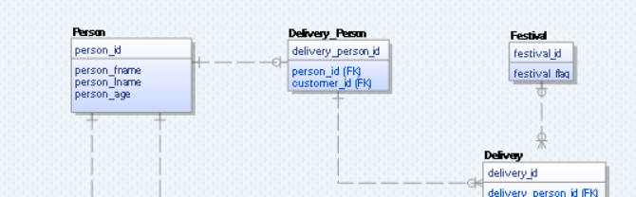
Erwin Data Model - Relationships
Relationships between tables can be 1:1, 1:M, or M:N.
It is not optimal to have a M:N relationship, so a bridge is constructed to avoid this relationship.
Within those connections though we had a few that could also take the value of zero since there were missing or NaN values in our dataset.
There could also be strong or weak relationships between the tables.
A strong relationship occurs when the parent entity’s primary key is a part of the child table’s primary key.
A weak relationship occurs when the primary key from the parent table is only a foreign key on the child’s entity.
Notes:
Brandon

Slide 11
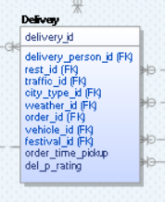
Common Constraints
Primary Key: one or more columns that uniquely identifies each row in a table. Inherently has a not null constraint. Each table can have only one primary key, but it can be made up of multiple columns in the dataset.
Foreign Key: Column or set of columns, which creates a link between its table and another table. Column designated as a foreign key is inherently not null.
Not Null: Ensures that a given column of a table is never assigned a null value. Prevents user from inserting a new record or updating without adding a value.
Unique: Ensures that all values in a column are different.
Notes:
Brandon

Slide 12
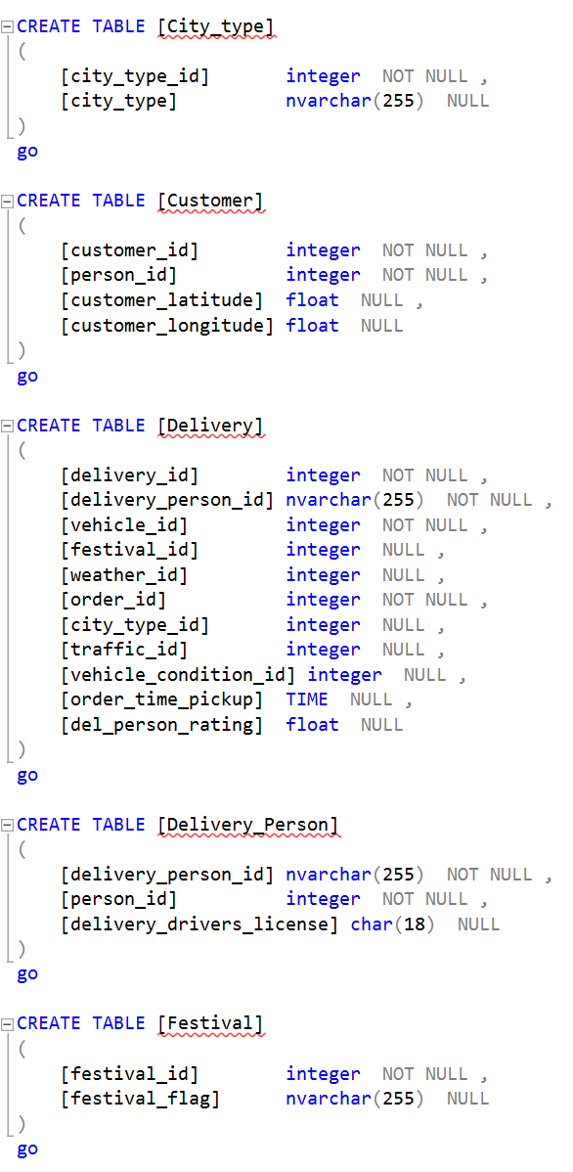
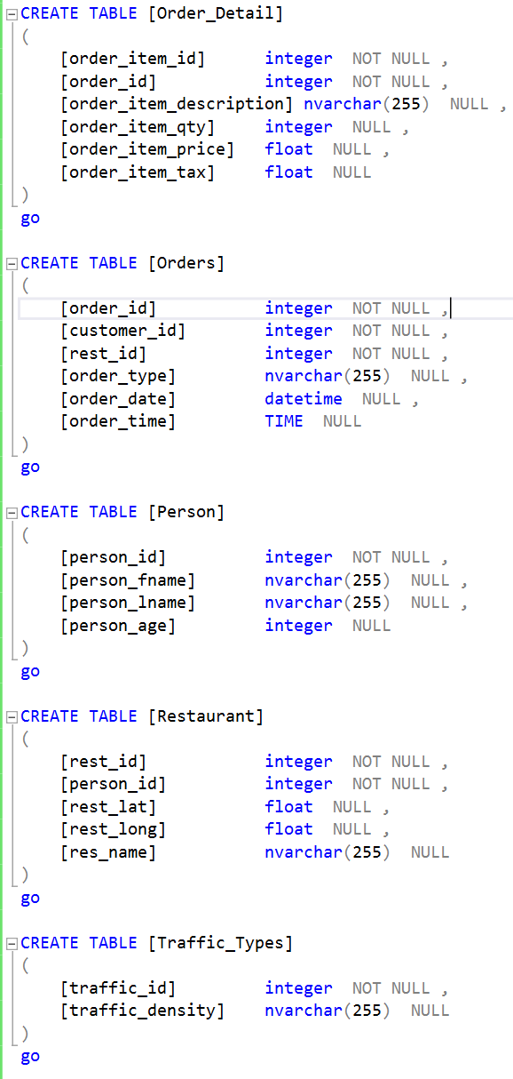
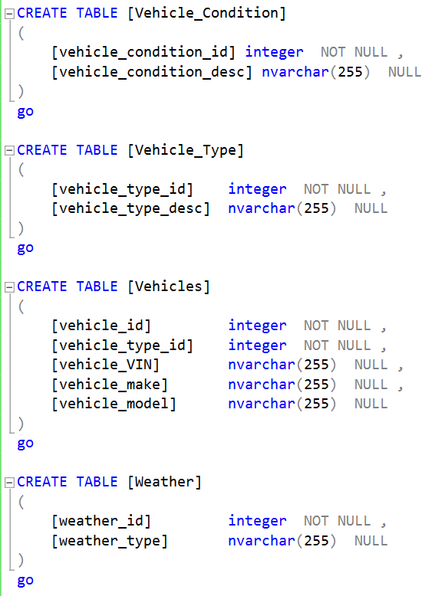
Database – SQL Statements
Notes:
Michael Webb

Slide 13
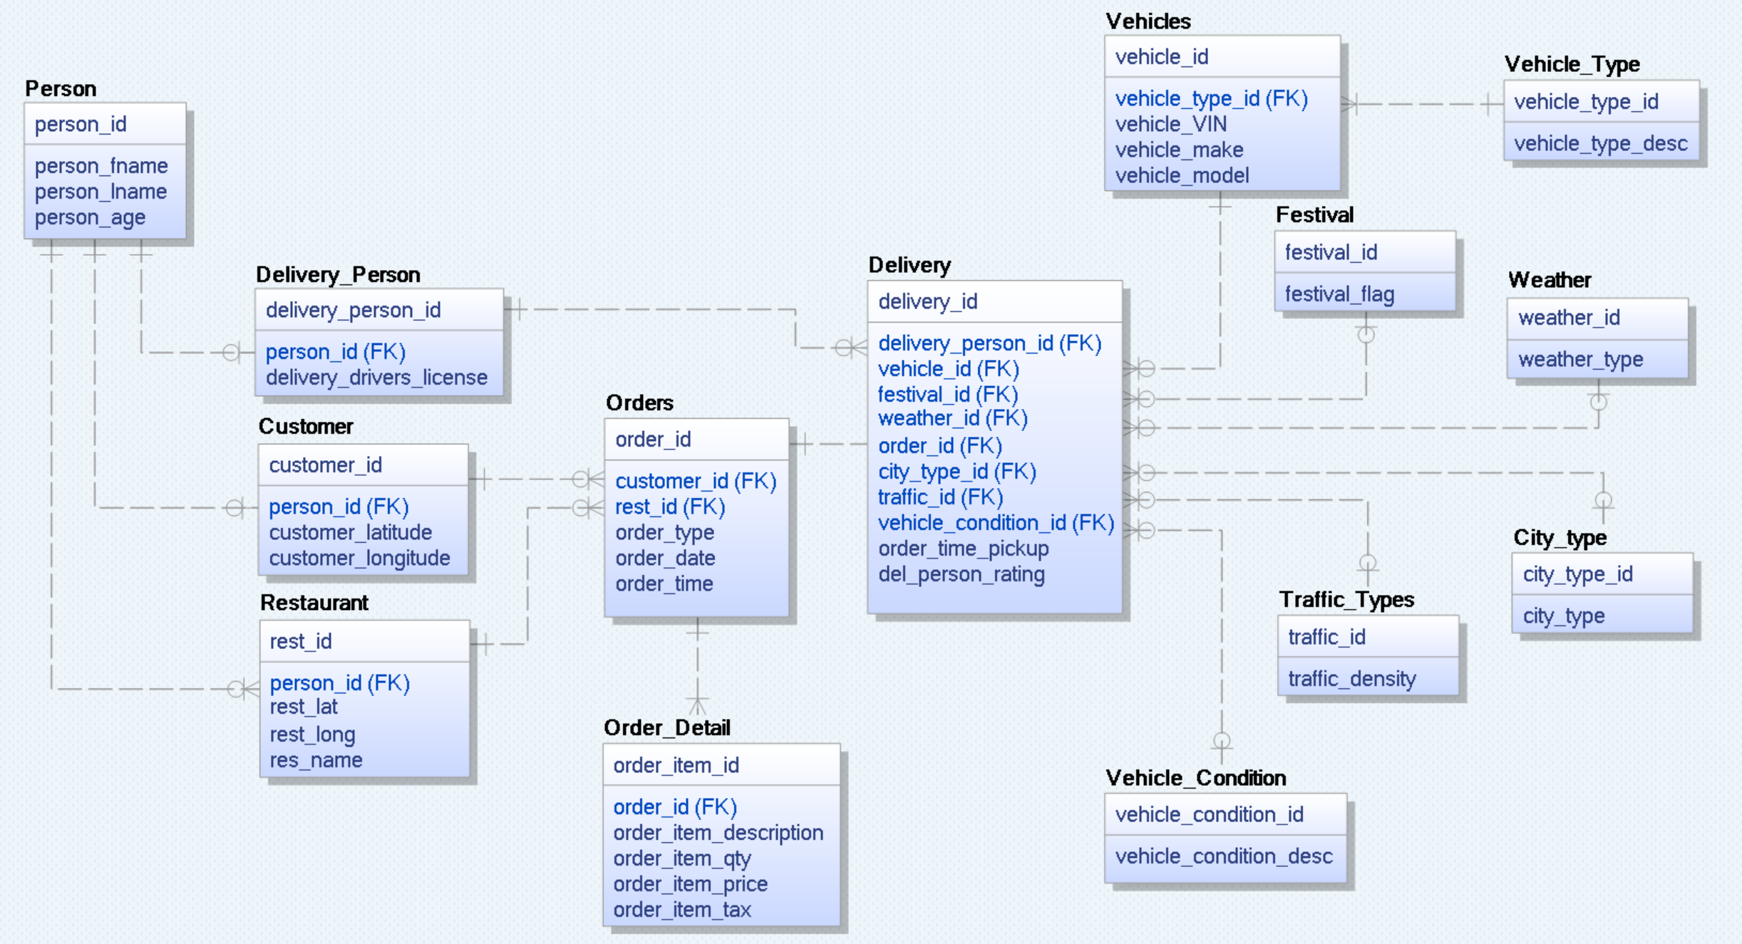
Database – Final Model
Notes:
Michael Webb

Slide 14
Database – Tables
Dimensional Table
Fact Table
Dummy Data
Person
Delivery Person
Customer
Restaurant
Orders
Order Detail
Vehicles
Vehicle Condition
Vehicle Type
Festival
Weather Type
City Type
Traffic Type
Orders
Delivery
Person
Order Detail
Vehicles
Vehicle Condition
Notes:
Michael Webb

Slide 15
Database – Columns
Notes:
Michael Webb

Slide 16
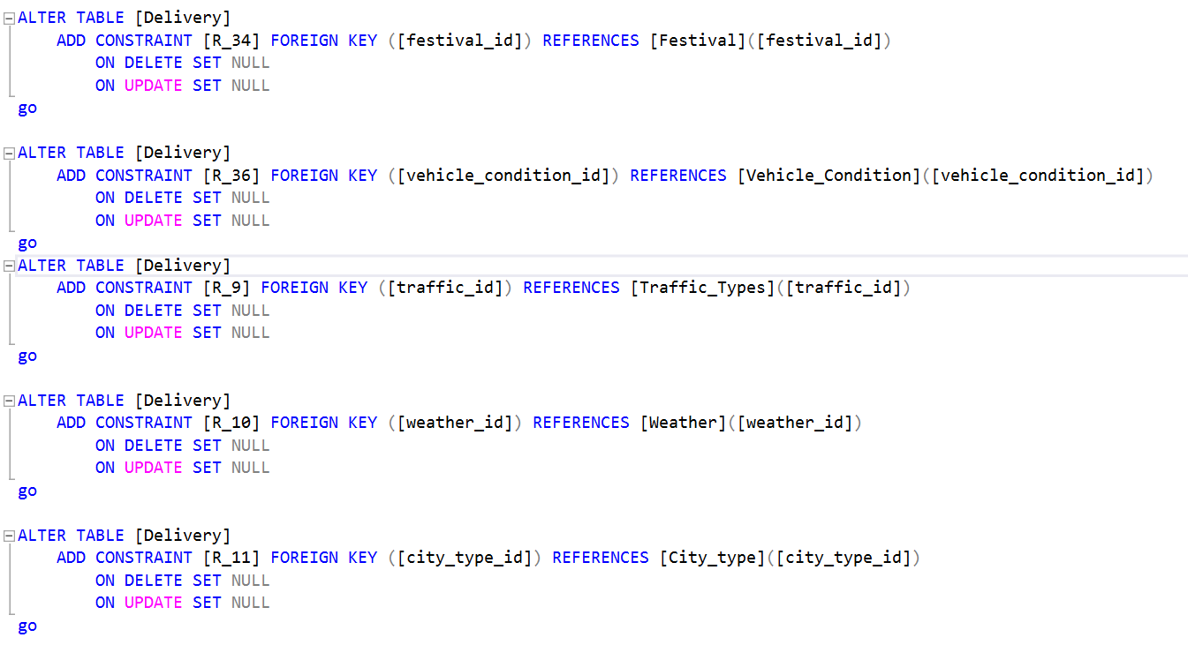
Database – Constraints
We used constraints to create foreign key references, primary keys, and allowing null values in some type tables.
Notes:
Michael Webb

Slide 17
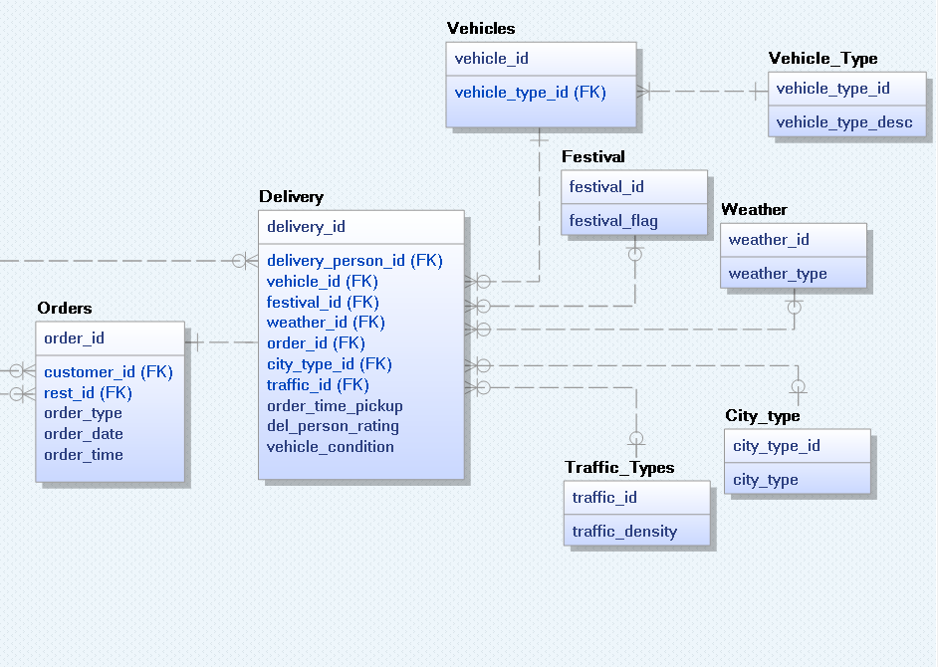
Data Warehouse – Fact Table
A fact table is the center of the schema and contain facts (or information) from the dimension tables
Using the Erwin Model, the main fact table that we created was the Delivery Table which was in the form of a snowflake schema.
The Delivery Table is at the center of the schema and took facts from the surrounding dimension tables: order, delivery_person_id, vehicle_id, weather, city_type, and traffic_type.
Notes:
Jonathan

Slide 18
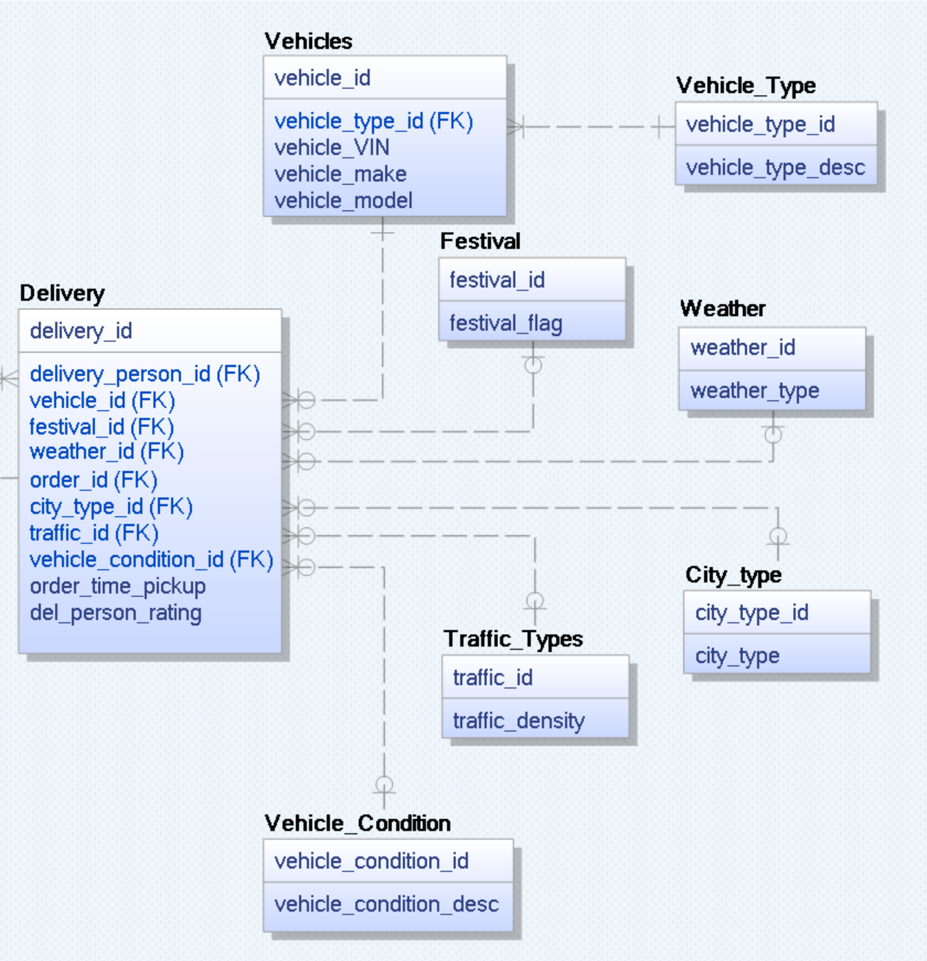
Data Warehouse – Dimension Tables
Dimension tables provide additional information to a fact.
Referring to the previous fact table that we created, three of the dimensions were weather, city_type, and traffic_type.
The dimension tables are providing additional information regarding the different conditions that could affect the delivery.
Notes:
Jonathan

Slide 19
Data Warehouse – Business Insights
Tracking delivery times
Could help with improving delivery person ratings
Can be combined with other data to give an ETA for deliveries
Look at how conditions effect delivery times
Look at how age and rating effect delivery times
Restaurant ratings
Look into avg order prep time
Vehicle maintenance
Make sure vehicles are brought in on condition and types of weather it drives in
Customer distance from restaurants
Give an ETA on delivery for customer
Multiple Deliveries
Make use of this column to give multiple deliveries to the most efficient drivers
Help with optimizing how deliveries are combined(route efficiency)
Notes:
Jonathan

Slide 20
Future Work
If we were to continue working on this dataset, we feel that it would be useful to start tracking the time that the deliveries were completed.
Also, we would try to eliminate the recording of null values, so the dataset could be more complete.
If the business is across various regions, then it will be useful to see data for different locations to see how it compares to the original dataset.
Notes:
Jonathan

Slide 21
References
https://www.kaggle.com/datasets/vikramxd/amazon-business-research-analyst-dataset
https://assessment.hackerearth.com/challenges/new/hiring/amazon-business-research-analyst-hiring-challenge/#about
Coronel, Carlos & Morris, Steven. Database Systems. Design, Implementation, and Management. 14th Edition. Cengage.

Slide 22
Thank You Are there any questions?

